Slide 1
Data Analytics Task 3 Data Visualization Presented By Victor Chukwuma Nwabufo STUDENT ID: CA/SE1/12728

Slide 2
# Import Libraries
import pandas as pd
import numpy as np
import matplotlib.pyplot as plt
import seaborn as sns
# Make plots visually appealing
sns.set(style="whitegrid")
plt.rcParams["figure.figsize"] = (8, 6)
# Load Dataset
# Upload your Excel file from Colab sidebar or Google Drive
from google.colab import drive
drive.mount('/content/drive')
df = pd.read_excel("/content/drive/MyDrive/CodeAlpha/Sample-Superstore.xls")
# Preview the dataset
df.head()

Slide 3
# Check column names
print("\nColumn names:\n", df.columns
# Explore and Clean the Data
# Check structure
df.info()
# Check for missing values
print("\nMissing values per column:\n", df.isnull().sum())
# Drop duplicates
df.drop_duplicates(inplace=True)
# Drop missing values (if any)
df.dropna(inplace=True)
# Verify dataset shape
print("\nDataset Shape after cleaning:", df.shape)
)

Slide 4
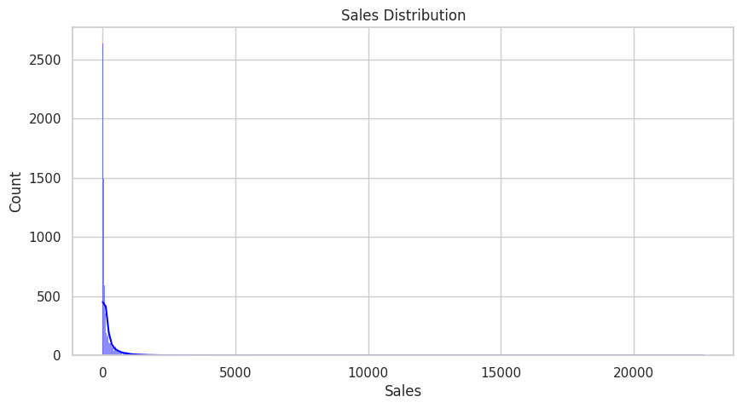
# Basic Statistical Summary
df.describe()
# Sales and Profit Distribution
df(['Sales', 'Profit']).describe
plt.figure(figsize=(10,5))
sns.histplot(df['Sales'], kde=True, color='blue')
plt.title('Sales Distribution')
plt.show()

Slide 5
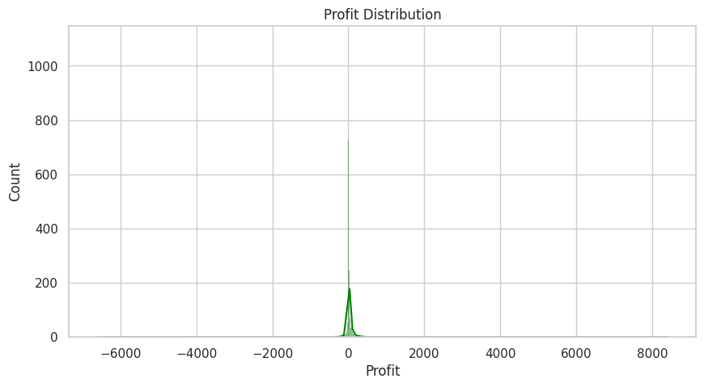
plt.figure(figsize=(10,5))
sns.histplot(df['Profit'], kde=True, color='green')
plt.title('Profit Distribution')
plt.show()
print('Sales are positively skewed — most transactions are small, few are large.’)
Sales are positively skewed — most transactions are small, few are large.

Slide 6
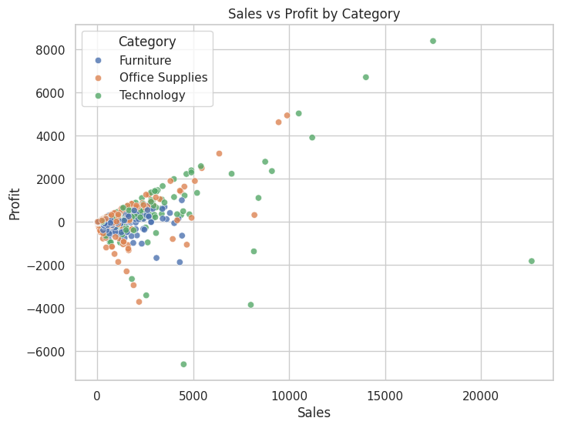
# Relationship: Sales vs Profit
plt.figure(figsize=(8,6))
sns.scatterplot(data=df, x='Sales', y='Profit', hue='Category', alpha=0.8)
plt.title("Sales vs Profit by Category")
plt.show()
print('Some high sales bring negative profit — possibly due to excessive discounts.')
Some high sales bring negative profit — possibly due to excessive discounts.

Slide 7
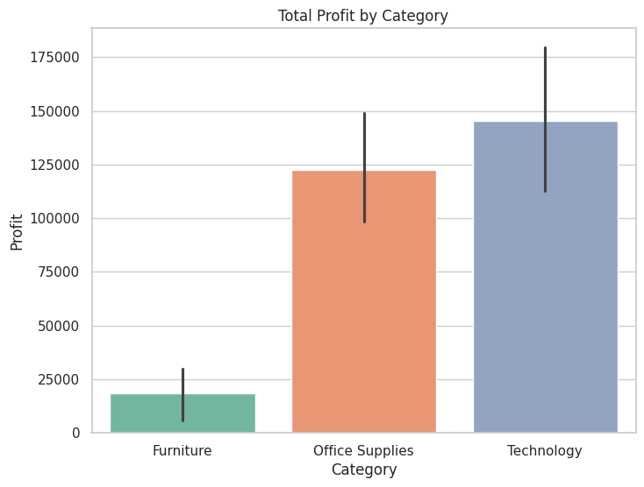
#Profit by Category
plt.figure(figsize=(8,6))
sns.barplot(data=df, x='Category', y='Profit', estimator=sum, palette='Set2')
plt.title("Total Profit by Category")
plt.show()
print("Technology is the most profitable category; Furniture often lags behind.")
Technology is the most profitable category Furniture often lags-behind.

Slide 8
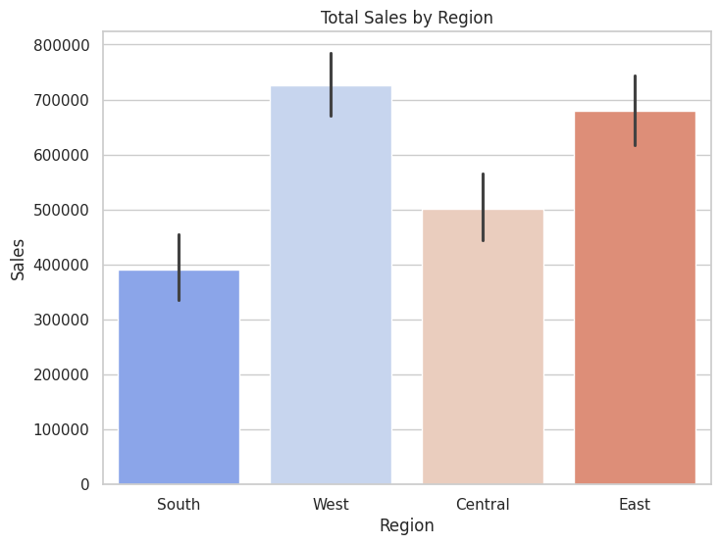
#Sales by Region
plt.figure(figsize=(8,6))
sns.barplot(data=df, x='Region', y='Sales', estimator=sum, palette='coolwarm')
plt.title("Total Sales by Region")
plt.show()
print("Western and Eastern regions dominate sales.")
Western and Eastern regions dominate sales.

Slide 9
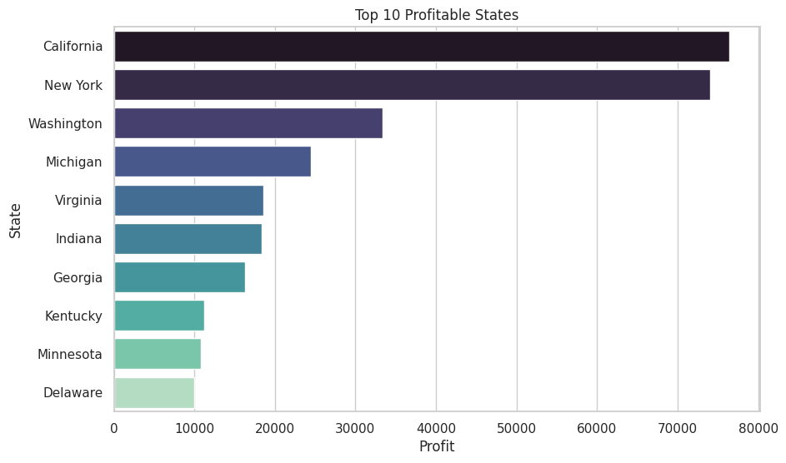
# Top 10 Profitable States
top_states = df.groupby('State')['Profit'].sum().sort_values(ascending=False).head(10)
plt.figure(figsize=(10,6))
sns.barplot(x=top_states.values, y=top_states.index, palette="mako")
plt.title("Top 10 Profitable States")
plt.xlabel("Profit")
plt.ylabel("State")
plt.show()
print("California and New York are the most profitable states.")
California and New York are the most profitable states.

Slide 10
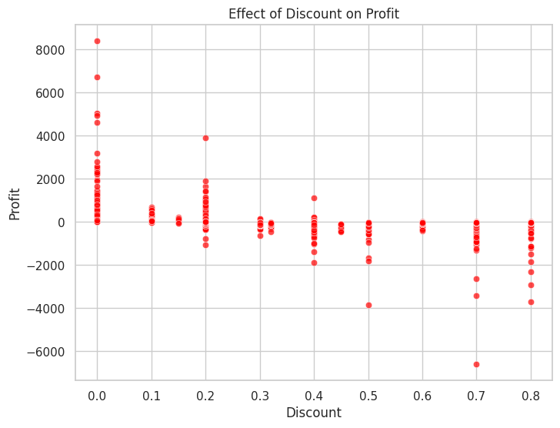
#Impact of Discount on Profit
plt.figure(figsize=(8,6))
sns.scatterplot(data=df, x='Discount', y='Profit', alpha=0.7, color='red')
plt.title("Effect of Discount on Profit")
plt.show()
print("Higher discounts have a negative impact on profit.")
Higher discounts have a negative impact on profit.

Slide 11
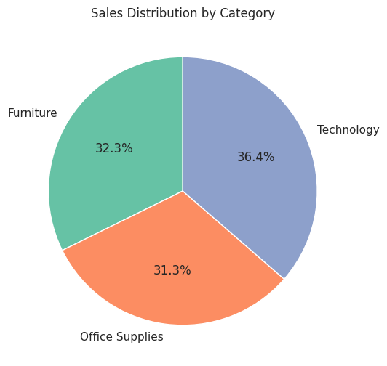
#Sales Share by Category (Pie Chart)
sales_by_category = df.groupby('Category')['Sales'].sum()
plt.figure(figsize=(6,6))
plt.pie(sales_by_category, labels=sales_by_category.index, autopct='%1.1f%%', startangle=90, colors=sns.color_palette('Set2'))
plt.title("Sales Distribution by Category")
plt.show()
print("Technology dominate sales.")
Technology dominate sales.

Slide 12
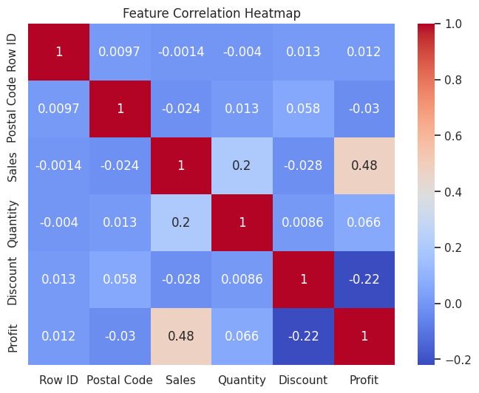
#Correlation Heatmap
plt.figure(figsize=(8,6))
sns.heatmap(df.corr(numeric_only=True), annot=True, cmap="coolwarm")
plt.title("Feature Correlation Heatmap")
plt.show()
print("Sales and Profit are moderately correlated; Discount is negatively correlated with Profit.")
Sales and Profit are moderately correlated; Discount is negatively correlated with Profit.

Slide 13
# Multi-Chart Dashboard fig, axes = plt.subplots(2, 2, figsize=(14,10))
sns.barplot(data=df, x='Category', y='Profit', estimator=sum, ax=axes[0,0],palette='coolwarm')
axes[0,0].set_title("Profit by Category")
sns.barplot(data=df, x='Region', y='Sales', estimator=sum, ax=axes[0,1],palette='coolwarm')
axes[0,1].set_title("Sales by Region")
sns.scatterplot(data=df, x='Discount', y='Profit', ax=axes[1,0],color='red')
axes[1,0].set_title("Discount vs Profit")
sns.heatmap(df.corr(numeric_only=True), annot=True, cmap="coolwarm", ax=axes[1,1])
axes[1,1].set_title("Correlation Heatmap")
plt.tight_layout()
plt.show()
print("This dashboard view summarizes key business patterns at once.")

Slide 14
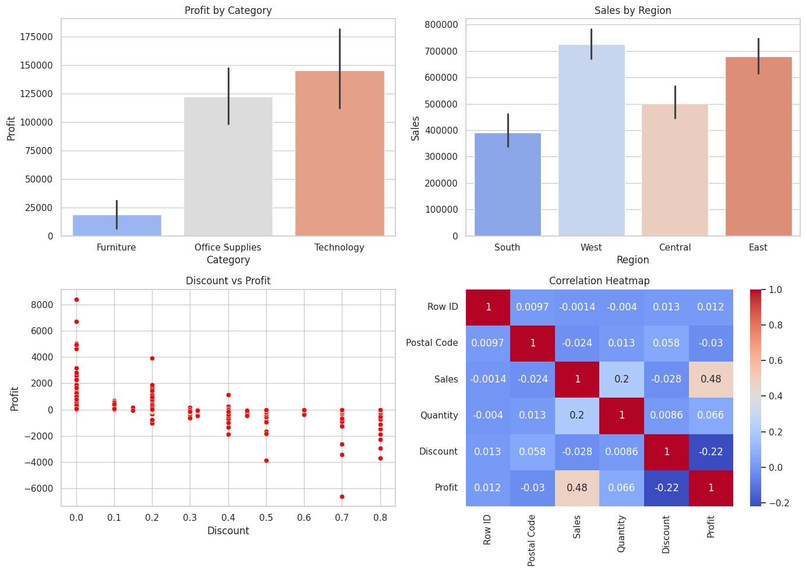
This dashboard view summarizes key business patterns at once.

Slide 15
# Data Storytelling
print('The Dataset Analysis shows that:')
print('\n1.The Technology category generates the most profit.')
print('\n2.The Furniture category has several loss-making transactions.')
print('\n3.High discounts significantly reduce profit margins.')
print('\n4.The West and East regions lead in sales, with California and New York as top-performing states.')
print('\n5.To improve profitability, discount rates should be optimized, and focus should shift to underperforming categories and regions.')
The Dataset Analysis shows that: 1.The Technology category generates the most profit. 2.The Furniture category has several loss-making transactions. 3.High discounts significantly reduce profit margins. 4.The West and East regions lead in sales, with California and New York as top-performing states. 5.To improve profitability, discount rates should be optimized, and focus should shift to underperforming categories and regions.

Slide 16
Key
# Key Findings
1
print('\n Key Findings: ')
2
print('\n* Heavy discounts reduce profit')
3
print('\n* Technology is the best-performing category')
4
print('\n* Western region dominates sales and profitability')
5
print('\n* Central and South regions need targeted strategies')
Key Findings:
Heavy discounts reduce profit
Technology is the best-performing category
Western region dominates sales and profitability
Central and South regions need targeted strategies

